Slide 1
Assembly Language Logical and Shift Instructions

Slide 2
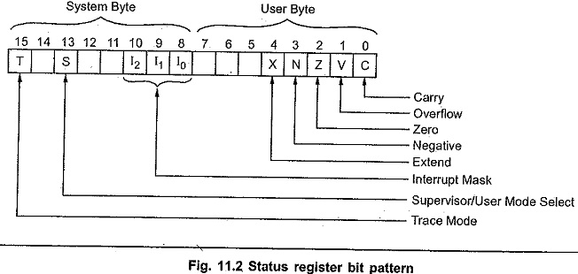
Status Register
Condition code status bits (X, N, Z, V and C)

Slide 3
The Carry (C) bit is set if there is a carry out of the most significant bit following an addition operation, or if a borrow is required from the most significant bit during a subtraction. This status (C) bit is also modified by certain shift and rotate instructions.

Slide 4
C
Example rule for the carry flag in arithmetic operation:
C is set if the addition of two numbers causes a carry out of the most significant (leftmost) bits added:
11111111 + 00000001 = 00000000 (carry flag is turned on)

Slide 5
If the sum of two numbers with the sign bits off yields a result number with the sign bit on: The "overflow" flag is turned on.
01000000 + 01000000 = 10000000 (overflow flag is turned on)
If the sum of two numbers with the sign bits on yields a result number with the sign bit off, the "overflow" flag is turned on.
10000000 + 10000000 = 00000000 (overflow flag is turned on)

Slide 6
The Zero (Z) bit is set whenever the result of an operation is zero; it is reset otherwise

Slide 7
The Negative (N) bit is the equivalent of the sign status bit.
N is equal to the value of the most significant result bit following arithmetic operations. If a signed binary arithmetic operation is being performed, a negative status of 0 specifies a positive or zero result, whereas a Negative status of 1 specifies a negative result.

Slide 8
The Extend (X) bit is set to the same state as the carry bit

Slide 9
C flag corresponds to unsigned arithmetic and the N and V flags correspond to signed arithmetic. The Z flag is valid for both.

Slide 10
Compare and Branch
A compare operation tests for equality or inequality
68K provides a compare instruction CMP source, destination, which:
evaluates [Rd – Rs]
and updates the bits in the CCR (condition code register) accordingly.
A compare instruction is inevitably followed by a branch instruction
that chooses one of two courses of action depending only on the outcome of the comparison.
Example:
High level construct :
if (x ==5) ( x = x +10)
Assembly fragment:
MOVE X, D0; put X in D0 CMP #5, D0; is X ==5? BNE EXIT; if not = goto EXIT
ADD #10, D0; else add 10 to X MOVE D0,X;restore X to memory EXIT.............
BNE EXIT forces a jump to the line labelled EXIT if the outcome of the compare operation yields ‘not zero’.

Slide 11
Logical Instructions
Logical operations allow you to directly manipulate bits of a word.
The AND operation is used to set particular bits to 0. A typical application of the AND instruction is to strip the parity bit off an ASCII-encoded character
Example:
AND #%01111111,D1;
Clears bit 7 of D1 to zero but leaves the bits 0 to 6 unchanged.

Slide 12
OR Instruction
The OR operation is used to set one or more bits of a word to 1. Oring a bit with 0 has no effect but Oring a bit with 1 sets it
The EOR operation is used to toggle (i.e invert) one or more bits. EORing a bit with 0 has no effect but EORing a bit with 1 inverts it
By using the NOT, AND, OR, EOR instructions, you can perform any logical operations on a word.

Slide 13
Clearing and Toggling Bits
Suppose you wish to clear bits 0, 1, 2, set bits 3, 4, 5 and toggle bits 6, 7 of the byte in D1
If [D1] initially contains
01010101₂
its final contents will be 10111000_{2.}
Example:
AND #%11111000, D1;
clear bits 0,1,2
OR #%00111000, D1;
set bits 3,4,5
EOR #%11000000, D1;
toggle bits 6 and 7.

Slide 14
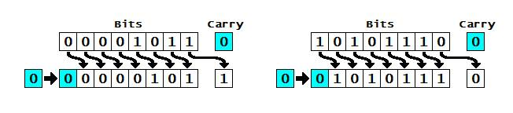
Logical Shift “right”

Slide 15
lsr.b #$02,d0
D0: 000004B2
B2 : 1011 0010
> 2 bits
0010 1100
0010 1100 in hex is 2C, which is saved back into d0.
Now d0 contains 0000042C.

Slide 16
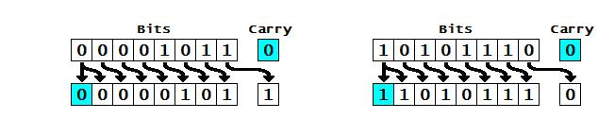
Arithmetic Shift Right

Slide 17
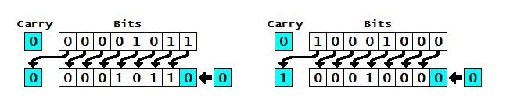
Arithmetic/Logical Shift Left

Slide 18
lsl.b #$02,d0
;d0 contains 000004B2
B2: 1100 1000
< 2
1100 1000 <
1100 1000 in hex is C8, which is saved back into d0. Now d0 contains 000004C8.

Slide 19
Shift instructions on data registers
Freedom to use, byte, word or long-word sizes
Shift more than 01 bit at a time
For memory though
you can only use word
Only shift 1 bit at a time.

Slide 20
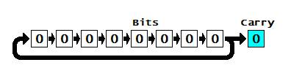
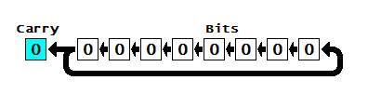
Rotating Left and Rotating Right

Slide 21
rol.b #$02, d0
This will rotate the byte of d0, 02 bits to the left. We’ll pretend that d0 contains 009F00B2 in this example, and since it’s a byte, only the B2 is change. B2 in binary is: 1011 0010
After rotating the bits left by 02, we get: 11001010

Slide 22
BSET
BSET (D0 : 00000000)
bset.l #$0E,d0
D0 00004000 (in binary: 0000 0000 0000 0000 0100 0000 0000 0000).
This instruction will set the bit number in the destination operand decided by the source operand, setting the bit to 1

Slide 23
BCLR and BCHG
bclr: This instruction will clear the bit number in the destination operand decided by the source operand, setting the bit to 0.
bchg: This instruction will change the bit number in the destination operand decided by the source operand, setting the bit from 0 to 1, or from 1 to 0.
This instruction will set the bit number in the destination operand decided by the source operand, setting the bit to 1

Slide 24
Compare and Branch
A branch instruction modifies the flow of control and causes the program to continue execution at the target address specified by the branch
The simplest branch instruction is the unconditional branch instruction, BRA target, which always forces a jump to the instruction at the target address

Slide 25
Branch Example
In the following fragment of code-
BRA HERE ; jump to the line that begins “HERE”
.
.
.
HERE ADD R0, D1
The BRA HERE INSTRUCTION forces the 68K to execute next the instruction on the line which is labelled by HERE.

Slide 26
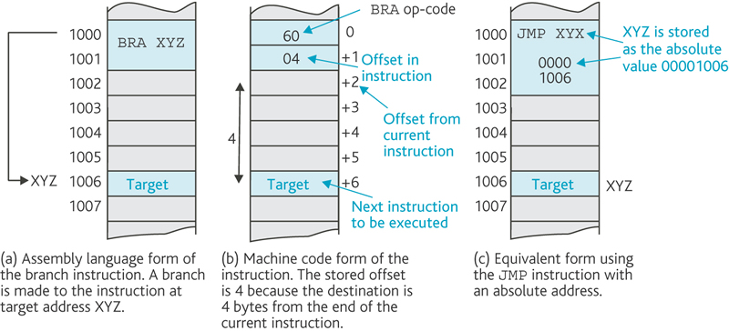
Branch and Offsets

Slide 27
68Ks (16) conditional branches
Mnemonic | Condition | Flags
BEQ | equal | Z = 1
BNE | not equal | Z = 0
BCS/BHS | carry set/higher or same | C = 1
BCC/BLO | carry clear/lower | C = 0
BMI | negative | N = 1
BPL | positive or zero | N = 0
BVS | overflow set | V = 1
BVC | overflow clear | V = 0
BHI | higher than (signed) | (C=1).(Z=0)
BLS | lower or same (signed) | (C=0)+(Z=1)
BGE | greater than or equal to (signed) | N = V
BLT | less than (signed) | N≠ V
BGT | greater then (signed) | (Z=0).(N=V)
BLE | less than or equal (signed) | (Z =1)+(N≠V)

Slide 28
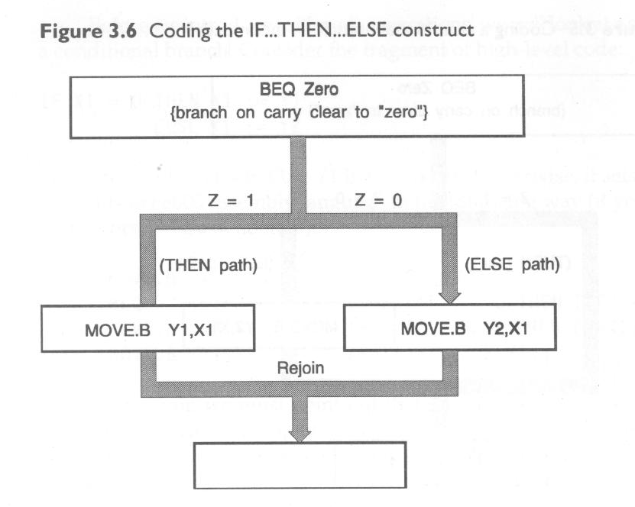

Slide 29
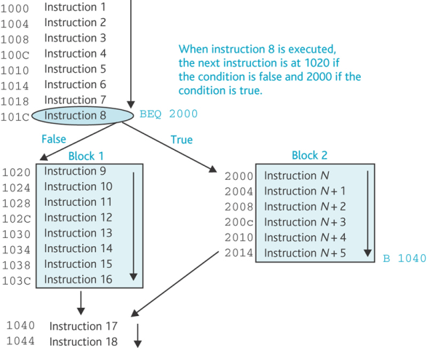

Slide 30
Application of Conditional Branching
The most important feature of any computer is its ability to implement conditional behaviour by carrying out a test and then branching on the result of the test.
If Statements:
High level construct:
if ( x == 3) then y = 4
68K Assembly Code:
CMP #3, D1 is( x == 3)?
BNE EXIT if x is not equal to 3, then quit
MOVE #4, D2 if x is 3 then y = 4
EXIT

